Slide 1
Long Island Population Health Improvement Project (LIPHIP)
August 11, 2016
This meeting is now being recorded.

Slide 2
LIHC/PHIP Establishment and Role
February 2013: Voluntarily, stakeholders from across Long Island-hospitals, both DSRIP performing provider systems, health departments, colleges, communities, faith based organizations, and more – convene to jointly work on Community Health Needs Assessments in Nassau and Suffolk Counties.
LIHC Prevention Agenda Focus Areas
Chronic Disease
Obesity
Preventive Care and Management
Behavioral Health as an area of overlay within intervention strategies.
September 2014: New York State Department of Health introduces the Population Health Improvement Program (PHIP).
LIHC sponsored programs and initiatives belong to LIHC member organizations and follow the collective impact model.
The role of the PHIP team includes convening key players, building consensus, organizing projects and supporting the needs of members as related to population health strategies.
We are here for YOU!
December 2014: The Long Island Health Collaborative receives funding through the PHIP and becomes the primary work group associated with carrying out the goals of the PHIP grant.

Slide 3
PHIP Updates
Long Island Association-Dr. Howard Zucker
PHIP 3rd Year Work Plan
NSHC Annual Meeting: AHA Presentation on Diversity
Event Recap: Sunset Stroll at Jones Beach, July 2016

Slide 4
Why Eliminate Disparities, Advance Diversity?
Right thing to do
Direct link to the Triple Aim and other state/federal requirements
Save money, lower legal risks, increase revenues and add economic benefits to society.
Significant vulnerability for the field
Meet changing needs/expectations of patients/communities
©American Hospital Association
M. Tomás León, MBA President and CEO, Institute for Diversity in Health Management
4

Slide 5
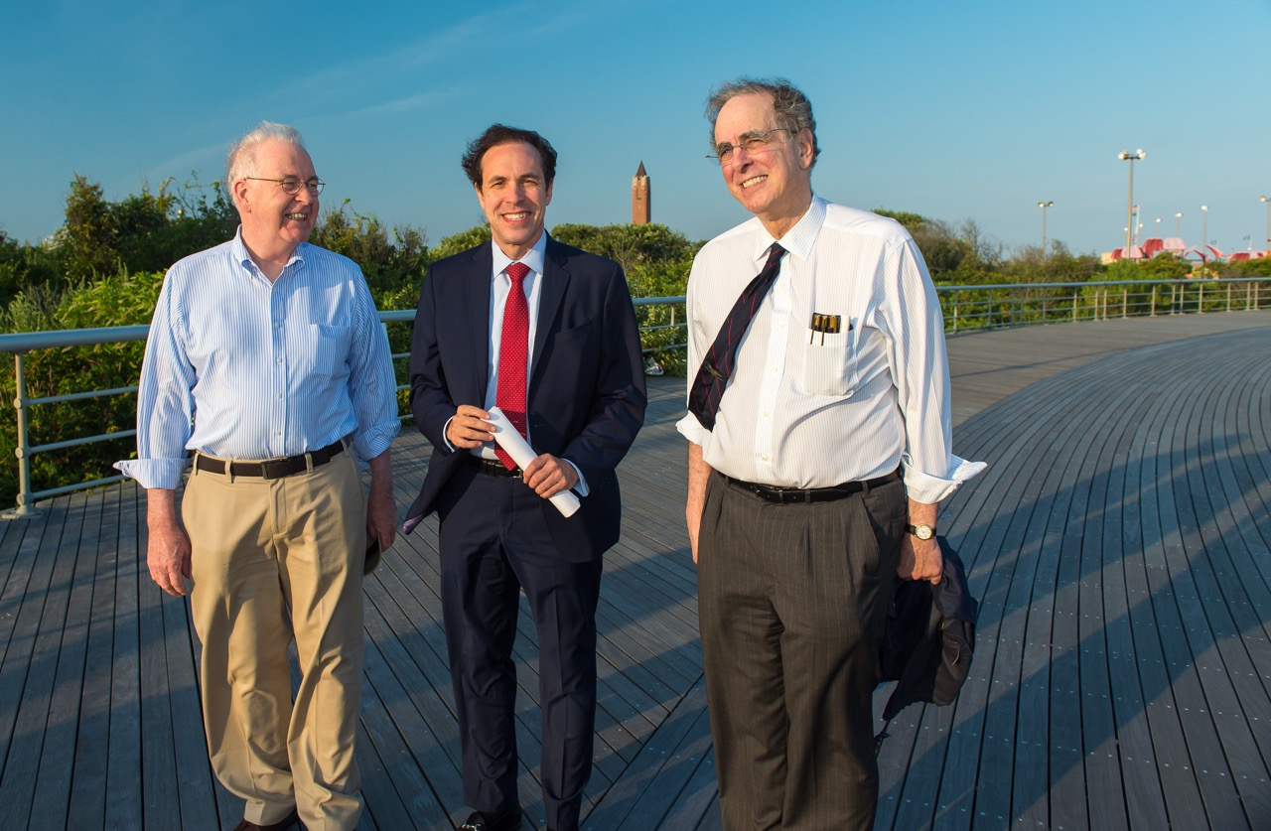
Public Education, Outreach and Community Engagement
Sunset Stroll at Jones Beach, July 21st 2016

Slide 6
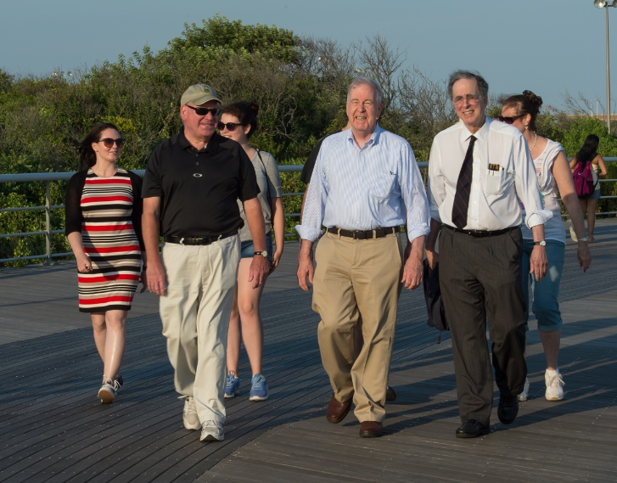
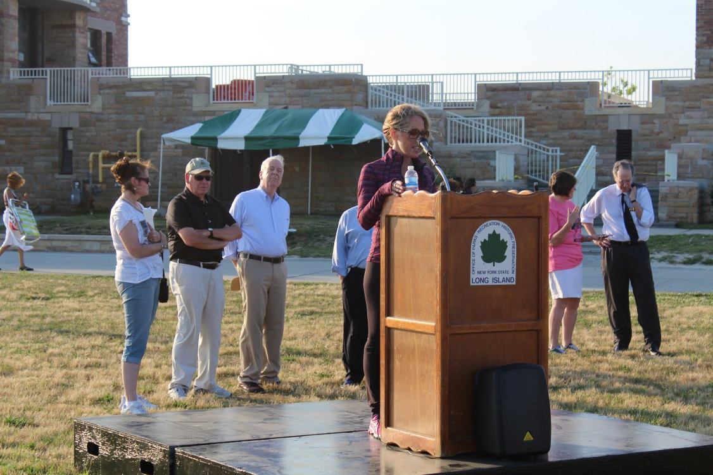
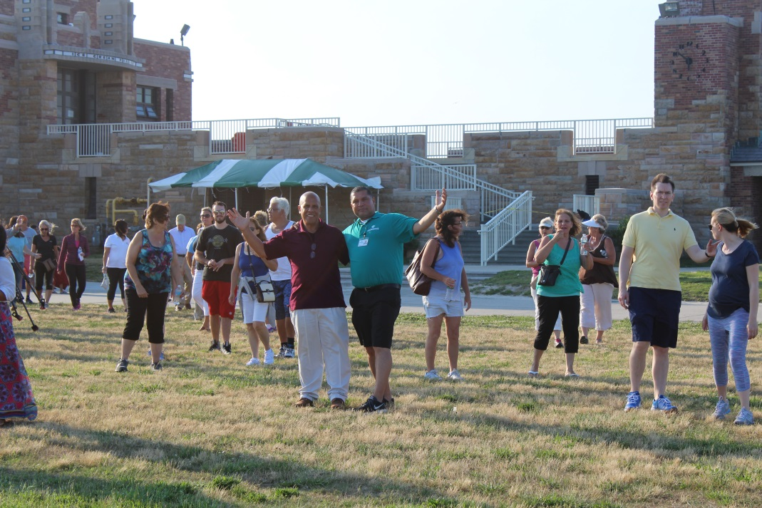

Slide 7
DSRIP Performing Provider System Partnerships
PPS Updates
Nassau-Queens PPS
PAC Meeting: September 15, 2016 9:30-11:30am Long Island Jewish Medical Center
Suffolk Care Collaborative
Project 2ai: Community Consumer Advisory Council
Project 4bii: NYS Prevention Agenda Alignment on Community Facing Webpage
Community Engagement Plan & Agency Coordination
Greater New York Hospital Association: Cultural Competency Training Sessions
PAC Meeting September 26, 2016 1-3pm Islandia Marriot
Building Bridges Events Fall 2016

Slide 8
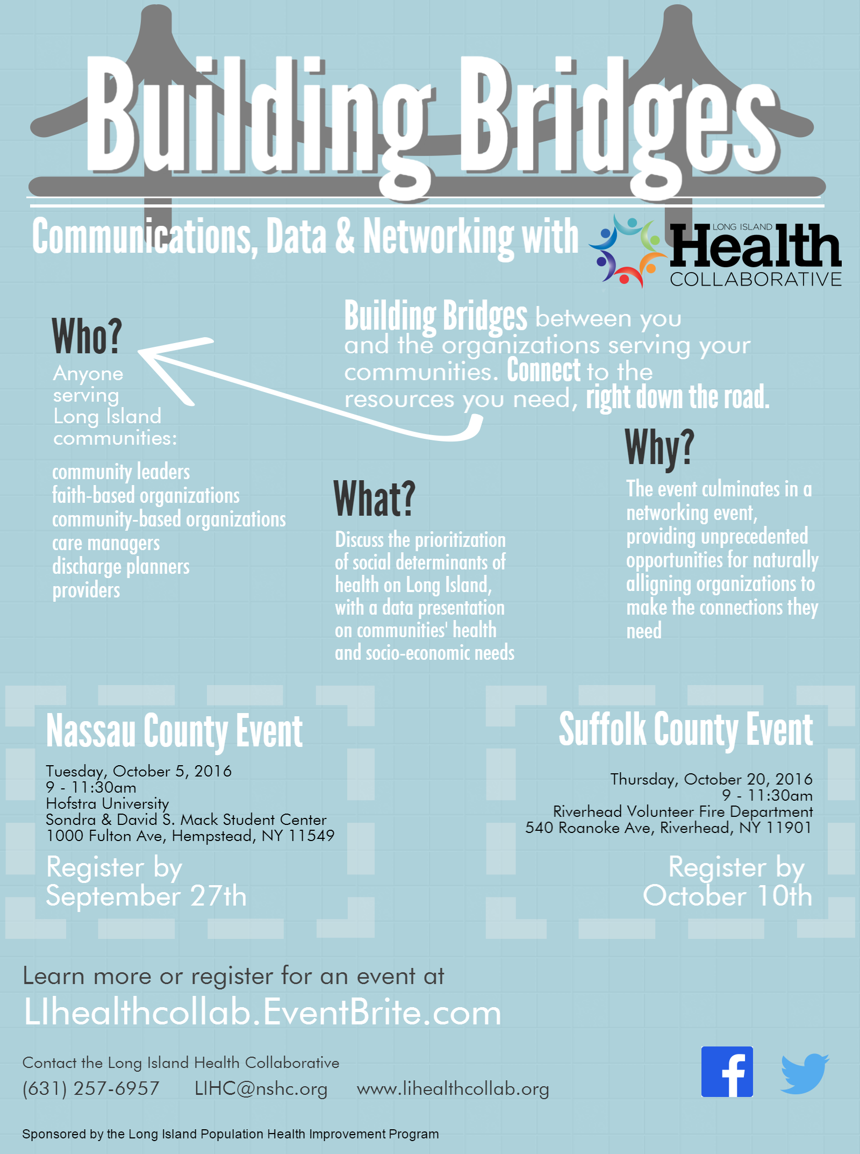

Slide 9
Growth of LIHC Membership
Membership
NYS DOH Healthy Resources
Networking Event Blast VS. LIHC Calendar
Networking Event Blast: To promote member fundraising or networking events
LIHC Calendar: Those events focused on learning about health resources or participating in healthy activities

Slide 10
LIHC Website, Portal and Social Media
Social Media Engagement Report

Slide 11
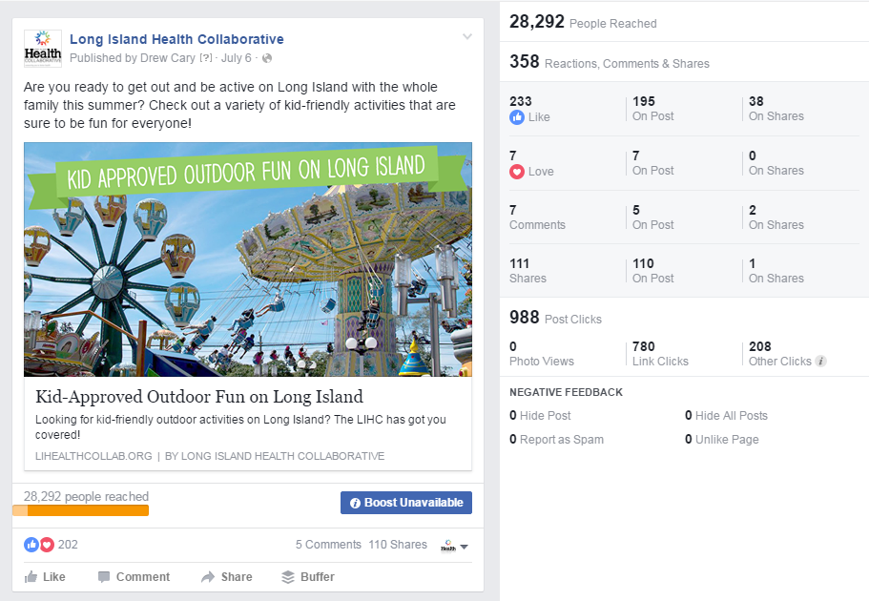
Facebook
Total likes: 546
Net likes: 136
Organic: 56
Boosted likes: 80
Total Reach: 107,793
Organic: 19,065
Boosted: 88,728
Total Post Engagement: 2583
July Total Posts: 21

Slide 12
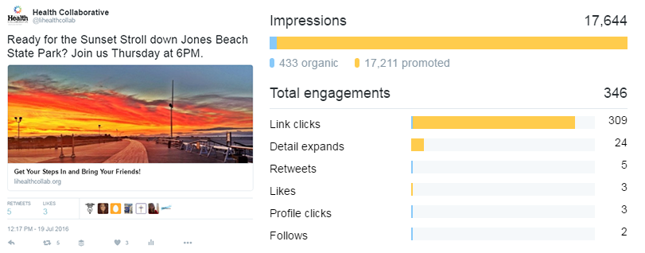
Twitter
Total followers: 197
Net followers: 9
Impressions: 67,500
Profile visits: 561
Mentions by others: 22
July Total Tweets: 48

Slide 13
Definitions
Net Likes/Followers – Net likes are the number of new likes minus the number of unlikes, giving us our total outcome.
Organic vs Boosted likes – Boosted likes are categorized as likes that occur within 1 day of viewing an advertisement, or 1 month (28 days) after clicking an advertisement. All other likes are considered organic.
Facebook Reach – Total reach is defined as the number of people who were served any activity from our Facebook Page including posts, posts to our Page by other people, Page like ads, and mentions.
Engagement – When a person interacts with a social post, by liking it, clicking on a link, expanding the text, clicking through the profile page, etc., these are considered engagements.
Twitter Impressions – An impression happens each time a users see our tweet in their Twitter feed.

Slide 14
Public Education Outreach & Community Engagement
Promotion of Are You Ready, Feet? ™
#ReadyFeet
Community Event Promotion
Next Workgroup Meeting:
To discuss website updates, community calendar, and promotion of building bridges

Slide 15
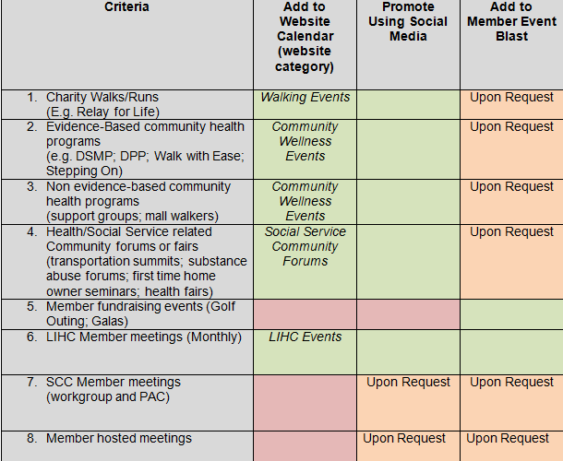
LIHC Rubric for Community Event Promotion

Slide 16
Community Event Calendar
Walking Events: Includes any opportunity where walking is the activity of focus. This category may include free community walking events or larger fundraising events where registration is required.
Community Wellness Events: Includes events focused on disease prevention and overall health wellness strategies. This may include exercise programs (Zumba or yoga) support groups (for those living with a chronic disease), health management programs (Diabetes self-management program, Walk with Ease) prevention programs (smoking cessation, cancer screenings) and farmers markets.
LIHC Sponsored: Any event coordinated by the Long Island Health Collaborative and its partners. Includes monthly collaborative meetings, networking events, community walks and beyond.
Social Service Programs: Any event where social determinants of health are addressed. This may include transportation summits, community forums, first time home owner seminars, insurance enrollment sites, etc.

Slide 17
LIHC Hashtags
#readyfeet
#healthcollab

Slide 18
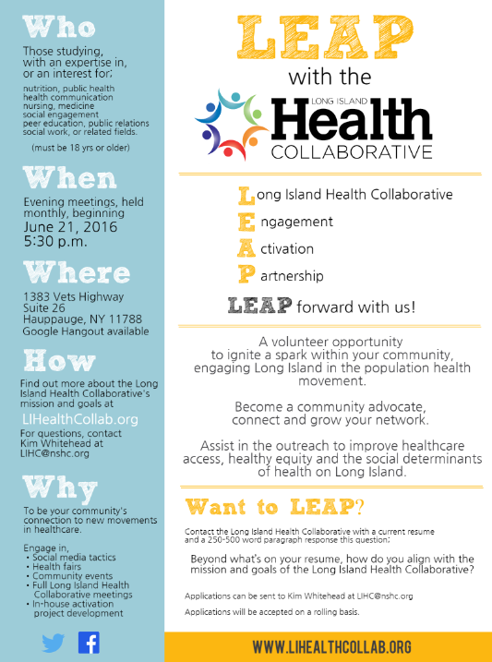
Academic Partners Workgroup
LIHC Engagement Activation Partnership (LEAP)

Slide 19
Committee Description: This committee is comprised of students and community advocates who hold a vested interest in improving access, health equity and social determinants of health care within communities on Long Island. The purpose of this committee is to light a spark in community members around population health and healthy living. Volunteers must be 18 years of age or older.
Target Audience: Cross-representation from academic institutions and multi-disciplinary fields of expertise on Long Island.
Audience may include, but not limited to, those with an expertise or interest in: nutrition, health communication, public health, nursing, medicine, social engagement, peer education, general communications or public relations.
Member Expectations: Attendance at evening monthly meetings; regular review of participation in activities

Slide 20
LIHC Activation Engagement Partnership
To apply: Send current resume and 250-500 word paragraph response to question below to LIHC@nshc.org “Beyond what’s on your resume, what makes you want to be involved in the mission and goals of the LIHC” Applications will be accepted on a rolling basis. Long Island Health Collaborative: For more information visit: www.lihealthcollab.org Or email LIHC@nshc.org

Slide 21
10 Minute Stretch Break & Sign up for Workgroup Participation

Slide 22
Complete Streets/Nutrition and Wellness
Creating Healthy Schools and Communities Grant NYS DOH
Eat Smart, New York (ESNY), USDA
PHIP Leveraging Existing Partnerships: Google Poll Response
Island Harvest Summer Lunch Sites

Slide 23
Grant | Creating Healthy Schools and Communities NYS DOH | SNAP-Ed Eat Smart New York (ESNY) USDA
Overview | Grant Partners: Western Suffolk BOCES, Sustainable Long Island, Stony Brook University Five-year (2015-2020) public health initiative to reduce major risk factors of obesity, diabetes, and other chronic diseases in high-need school districts and associated communities statewide. Goal: to implement multi-component evidence-based policies, place-based strategies, and promising practices to increase demand for and access to healthy, affordable foods and opportunities for daily physical activity. | Grant Partners: Cornell Cooperative Extension (Nassau and Suffolk), Family Residences and Essential Enterprises (FREE) Five-year (2014-2019)community-based nutrition education and obesity prevention program to reduce major risk factors of obesity, diabetes, and other chronic diseases in high-need school districts and associated communities statewide. SNAP-Ed ESNY utilizes a variety of hands-on education strategies in the community and partnering agencies. Goal; to implement comprehensive multi layered evidence based strategies : improve the likelihood that persons eligible for SNAP will make healthy food choices within a limited budget and choose physically active lifestyles consistent with the current Dietary Guidelines for Americans and the associated USDA Food Guidance System, My Plate.
Target | Targeted communities: Brentwood, Central Islip, Southampton/Shinnecock Indian Nation, Wyandanch and Roosevelt | Suffolk and Targeted communities: in Nassau Roosevelt Uniondale, Glen Cove, Hempstead, Freeport,

Slide 24
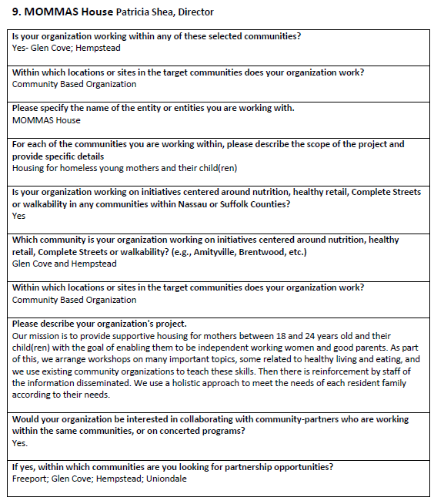
Partnership Google Poll

Slide 25
Cultural Competency/Health Literacy Workgroup
Update on CCHL Vendor and Training

Slide 26
Behavioral Health Workgroup
Workgroup Goal: Provide opportunities for Mental Health and Substance Abuse education to health professionals of all disciplines and members of the Long Island Health Collaborative.
Wednesday August 17, 10:30am

Slide 27
Behavioral Health Part I-Mental Health Part II- Substance Abuse (September Meeting)

Slide 28
Quick Facts about Mental Health
In 2012 Long Island had
389,268 adults with “Any Mental Illness”
150,732 adults with “At Least One Major Depressive Episode”
68,329 adults with “Serious Mental Illness”
77,248 adults with “Serious Thought of Suicide”
In 2013 Long Island had
391,409 adults with “Any Mental Illness” (+.55%)
151,545 adults with “At Least One Major Depressive Episode” (+.54%)
68,703 adults with “Serious Mental Illness” (+.55%)
77,749 adults with “Serious Thought of Suicide” (+.65%)
*Source: Conference of Local Mental Hygiene Directors Behavioral Health Information Portal— National Survey on Drug Use and Health (NSDUH)

Slide 29
The Effect of Mental Health on the Population – National Survey on Drug Use and Health – Estimated Prevalence of the 18+ Population
2012 | Nassau | Suffolk | Long Island | New York State
Any Mental Illness | 17.7% | 17.7% | 18% | 19%
At Least One Major Depressive Episode | 7% | 7% | 7% | 7%
Serious Mental Illness | 3.1% | 3.1% | 3% | 4%
Serious Thoughts of Suicide | 3.5% | 3.5% | 4% | 4%
2013 | Nassau | Suffolk | Long Island | New York State
Any Mental Illness | 17.7% | 17.7% | 18% | 19%
At Least One major Depressive Episode | 7% | 7% | 7% | 7%
Serious Mental Illness | 3.1% | 3.1% | 3% | 4%
Serious Thoughts of Suicide | 3.5% | 3.5% | 4% | 4%
*Source: Conference of Local Mental Hygiene Directors Behavioral Health Information Portal— National Survey on Drug Use and Health (NSDUH)

Slide 30
ICD 9 Codes Used
Mental Diseases and Disorders-primary diagnosis (ICD 9):
Psychosis (290-299)
Neurotic disorders, personality disorders, and other nonpsychotic mental disorders (300-316)
Mental retardation (317-319)
Excluding:
291.0-291.9 - Alcohol induced mental disorders;
292.0-292.9 - Drug induced mental disorders;
303.0-303.9 - Alcohol dependence syndrome;
304.0-304.9 - Drug dependence syndrome.
Self Inflicted Injury E-Code (ICD 9):
Suicide and Self-Inflicted Injury (E950-E959)

Slide 31
Mental Health Indicators
 | Nassau | Suffolk | Long Island | NYS | NYSxNYC | Target
% adults with poor mental health for 14+ days in last month (2013-2014)* | 8.0% | 13.8% | 11.1% | 11.5% | N/A | 10.1%
Average Age Adjusted mental disease and disorder ED Visits/100,000 (2012-2014)** | 1296.35 | 1524.80 | 1418.76 | 1979.86 | 1728.09 | N/A
Average Age Adjusted mental disease and disorder hospitalizations/100,000** | 445.59 | 421.46 | 429.47 | 600.27 | 552.84 | N/A
Adjusted suicide mortality/100,000* | 6.4 | 8.9 | 7.7 | 7.8 | N/A | 5.9
Average Age Adjusted self-inflicted injury ED visits/100,000** | 63.07 | 87.16 | 76.00 | 105.41 | 132.72 | N/A
Average Age Adjusted self-inflicted injury hospitalization/100,000** | 55.01 | 54.05 | 54.49 | 58.15 | 68.29 | N/A
*Prevention Agenda Dashboard (2013-2018)
**SPARCS Database 2012-2014

Slide 32
Average Age Adjusted Mental Disease and Disorder
Rates by Gender
Hospitalizations/100,000 (2012-2014)** | Nassau | Suffolk | Long Island | NYS | NYSxNYC
Male | 465.59 | 434.96 | 446.74 | 650.81 | 560.34
Female | 426.65 | 422.76 | 420.56 | 553.01 | 545.35
ED Visits/100,000 (2012-2014)** | Nassau | Suffolk | Long Island | NYS | NYSxNYC
Male | 1440.17 | 1673.19 | 1564.89 | 2320.57 | 1831.20
Female | 1160.15 | 1432.12 | 1303.64 | 1660.59 | 1627.63
**SPARCS Database 2012-2014

Slide 33
Average Age Adjusted Mental Disease and Disorders Rate by Race/Ethnicity
Hospitalizations/100,000 (2012-2014)** | Nassau | Suffolk | Long Island | NYS | NYSxNYC
Male - White | 442.12 | 425.91 | 419.63 | 480.33 | 503.01
Female - White | 418.09 | 429.02 | 408.95 | 465.13 | 505.23
Male - Black | 962.34 | 758.63 | 945.86 | 1250.35 | 1022.50
Female – Black | 665.07 | 502.91 | 663.01 | 814.80 | 863.93
Male – Hispanic | 289.45 | 189.06 | 242.63 | 531.72 | 483.20
Female - Hispanic | 328.62 | 204.05 | 278.58 | 437.49 | 484.45
**SPARCS Database 2012-2014

Slide 34
Average Age Adjusted Mental Disease and Disorders Rate by Race/Ethnicity
ED Visits/100,000 (2012-2014)** | Nassau | Suffolk | Long Island | NYS | NYSxNYC
Male - White | 1371.57 | 1525.82 | 1457.63 | 1584.48 | 1590.84
Female - White | 1147.96 | 1355.20 | 1263.54 | 1328.46 | 1474.75
Male - Black | 2698.18 | 2601.18 | 2655.52 | 4300.06 | 3240.48
Female – Black | 1830.39 | 1862.71 | 1847.28 | 2490.16 | 2530.59
Male – Hispanic | 1413.45 | 1193.04 | 1287.17 | 2532.40 | 1933.73
Female - Hispanic | 1185.03 | 1057.84 | 1110.72 | 1655.66 | 1708.39
**SPARCS Database 2012-2014

Slide 36
Average Age Adjusted Self-Inflicted Injury
Rates by Gender
Hospitalizations/100,000 (2012-2014)** | Nassau | Suffolk | Long Island | NYS | NYSxNYC
Male | 39.99 | 43.94 | 42.08 | 50.28 | 55.71
Female | 69.75 | 66.00 | 67.79 | 65.67 | 80.41
ED Visits/100,000 (2012-2014)** | Nassau | Suffolk | Long Island | NYS | NYSxNYC
Male | 47.94 | 73.24 | 61.50 | 92.89 | 110.57
Female | 77.88 | 103.98 | 91.69 | 117.46 | 154.35
**SPARCS Database 2012-2014

Slide 37
Average Age Adjusted Self-Inflicted Injury Rate by Race/Ethnicity
Hospitalizations/100,000 (2012-2014)** | Nassau | Suffolk | Long Island | NYS | NYSxNYC
Male - White | 44.52 | 44.03 | 44.19 | 47.47 | 53.83
Female - White | 73.98 | 65.01 | 69.07 | 66.76 | 78.50
Male - Black | 36.09 | 40.14 | 37.87 | 53.66 | 62.16
Female – Black | 54.51 | 61.02 | 57.05 | 55.48 | 78.53
Male – Hispanic | 26.76 | 24.90 | 25.54 | 40.73 | 49.89
Female - Hispanic | 62.98 | 42.55 | 51.38 | 53.30 | 75.64
**SPARCS Database 2012-2014

Slide 38
Average Age Adjusted Self-Inflicted Injury Rate by Race/Ethnicity
ED Visits/100,000 (2012-2014)** | Nassau | Suffolk | Long Island | NYS | NYSxNYC
Male - White | 52.82 | 65.94 | 60.16 | 84.16 | 102.06
Female - White | 84.88 | 95.19 | 90.70 | 117.27 | 146.71
Male - Black | 50.06 | 66.63 | 57.52 | 109.52 | 149.22
Female – Black | 72.96 | 110.44 | 89.08 | 103.62 | 171.73
Male – Hispanic | 41.61 | 71.61 | 58.26 | 103.55 | 135.40
Female - Hispanic | 91.69 | 112.47 | 102.75 | 130.40 | 201.86
**SPARCS Database 2012-2014

Slide 40
Substance Abuse
Speaking with other PHIPS to determine which codes belong in this category so that all of our calculations are consistent

Slide 41
Data Workgroup Continued..
Wellness Portal and Complementary Training Session for Wellness Survey Use

Slide 42
Grant Opportunities
New York State Innovation Model (SIM): Linking Interventions for Total Population Health
New York State Health Foundation Sponsoring Conference Participation in Support of Healthy Communities

Slide 43
Questions/Feedback?

Slide 44
Upcoming Meetings
September 14, 2016: 2:30-4:30pm
October 13, 2016: 9:30-11:30am
November 9, 2016: 2:30-4:30pm

